Slide 1

ECG Analysis using ML
2022UIC3598 MAYANK KUMAR
2022UIC3603 RITIK JAIN
2022UIC3605 AKHSAY SHARMA
2022UIC3635 SHANU YADAV

Slide 2
CONTENTS
Introduction
Literature Survey
Gaps Identified
Aims/Objectives of the Project
Dataset & Preprocessing
Solution Methodology
Results
Future Scope
References

Slide 3
INTRODUCTION
Cardiovascular diseases (CVDs) are the leading cause of death globally.
12 lead ECGs are is a key diagnostic tool for detecting heart abnormalities.
Manual interpretation of ECG strips is time-consuming and prone to human error.
To develop a Deep Learning (DL) model capable of segmenting heartbeats (P, QRS, T) and classifying multiple abnormalities with high sensitivity.
Thereby improving accessibility to cardiac diagnosis, primarily in low-resource healthcare settings where expert cardiologist are not available.

Slide 4
Gaps Identified
What’s missing?
1. Most existing models focus only on classification (Sick vs. Healthy) but ignore segmentation (where the P/QRS/T waves are).
2. Lack of explainability—doctors don't trust "Black Box" models.
3. Performance drops in the presence of real-world noise (Motion artifacts).

Slide 5
Aim of the Project
To develop a deep learning based automated system capable of accurately detecting and classifying multiple cardiac abnormalities from 12 lead ECG signal, thereby assisting clinicians in fast and reliable heart disease diagnosis.

Slide 6
Dataset and Preprocessing
Dataset Selection: We used PTB-XL dataset. This dataset contains thousands of heartbeats annotated by expert cardiologists.
Filtering: Raw ECGs are messy due to following noises:
Power-line Interference: 50/60 Hz hum from electrical sockets.
Baseline Wander: The "drifting" of the signal caused by the patient breathing.
This ensures the model focuses on the shape of the wave, not just how tall it is.

Slide 7
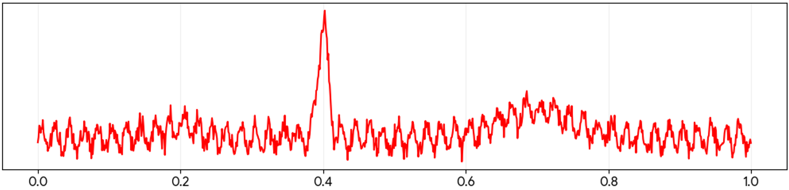
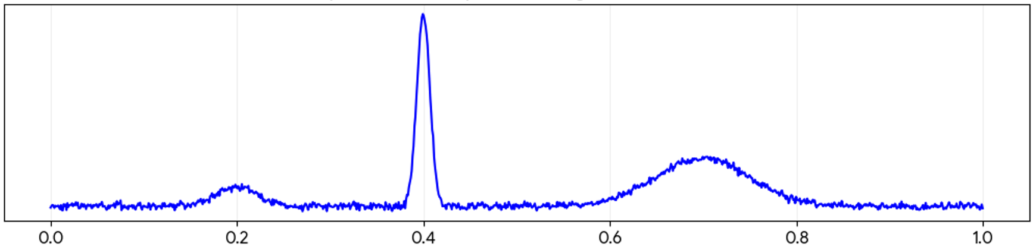
Raw ECG Signal
Filtered ECG Signal

Slide 8
Solution Methodology
1. Input Layer: The ECG signal is a 1D array of voltage values.
2. Preprocessing: 1D-Butterworth Filtering + Z-score Normalization.
3. Core Model: 1D-CNN (Convolutional Neural Network). The model doesn't look at the whole signal at once. It uses 1D Convolutional kernels (filters) that slide over the signal. These filters act as automated "feature detectors" for slopes, peaks, and segments.
4. Decision Making (Fully Connected Layers): After the convolutions find the patterns, these final layers act like a "voting committee" to decide which abnormality the patterns represent.

Slide 9
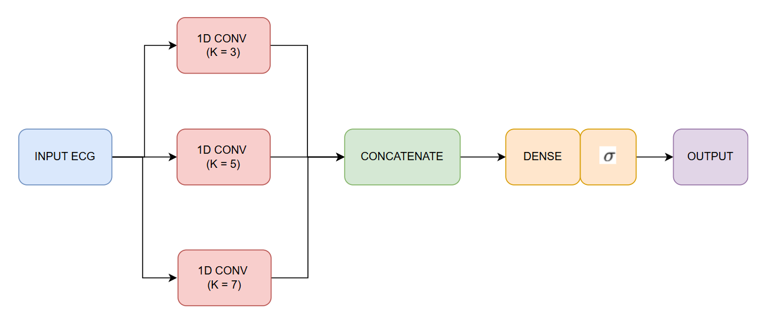
System Architecture

Slide 10
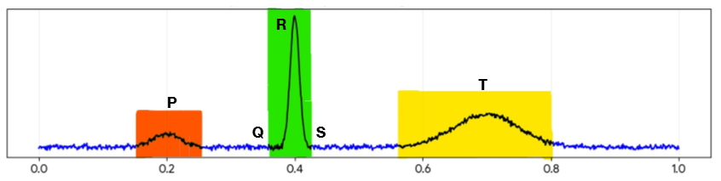
Segmented ECG Signal

Slide 11
RESULT
The evaluation of 1D CNN model is done using performance plot of Precision, Recall and F1 Score for all cardiac abnormalities.
The results demonstrates high precision and recall across all abnormalities ensuring that the amount of false positives and false negatives are within acceptable range.

Slide 12
 | Precision | Recall | F1 Score
1dAVB | 0.867 | 0.929 | 0.897
ST | 0.833 | 0.938 | 0.960
SB | 0.947 | 0.973 | 0.882
RBBB | 0.895 | 0.992 | 0.944
LBBB | 0.998 | 0.987 | 0.993
AF | 0.986 | 0.769 | 0.807
WPW | 0.870 | 0.723 | 0.778
ST-Elevation | 0.858 | 0.893 | 0.792
V-Tach | 0.921 | 0.872 | 0.813
PVC | 0.766 | 0.709 | 0.815
Precision, Recall, F1 scores

Slide 13
Performance Plot

Slide 14
Future Scope
Integration of Explainable AI (XAI): A major barrier to AI adoption in medicine is the "black box" nature of neural networks. Future work will highlight exactly which part of the ECG signal (e.g., a widened QRS or an inverted T-wave) led the model to its diagnosis, providing clinicians with a visual "reasoning" they can trust.
Deployment on Edge Devices: Integrate this model to wearables for on-device arrhythmia detection in smartwatches and portable ECG patches.
Reduce Latency: A potential bottleneck in the current workflow is the latency between data acquisition and model output to minimize computation time and move toward Real-Time Clinical Monitoring.

Slide 15
References
Book
[1] R. Kumar, Bio-Medical Signal Processing, 1st ed. New Delhi, India: S.K. Kataria & Sons, 2024.
Research Articles
[2] Potharaju, S., "Multi-resolution hybrid sliding window approach for ECG arrhythmia detection using deep learning models." International Scientific Journal of Engineering and Management, 2026
[3] Rahman, A., "ECG Classification for Detecting ECG Arrhythmia Empowered with Deep Learning Approaches." International Journal of Intelligent Systems, 2026
[4] Wagner, P., "PTB-XL, a large publicly available electrocardiography dataset." Scientific Data, 2020.
[5] Zhu, H., "A Multi-Scale 1D Convolutional Neural Network for ECG Classification." IEEE Access, 2021
[6] Sahoo, S., "Arrhythmia Classification Using 1D Convolutional Neural Network." 2020 International Conference on Communication and Signal Processing (ICCSP), 2020.

Slide 16
THANK YOU
2022UIC3598 MAYANK KUMAR
2022UIC3603 RITIK JAIN
2022UIC3605 AKHSAY SHARMA
2022UIC3635 SHANU YADAV

